Slide 1
Data and Analytics (Targeting)

Slide 2
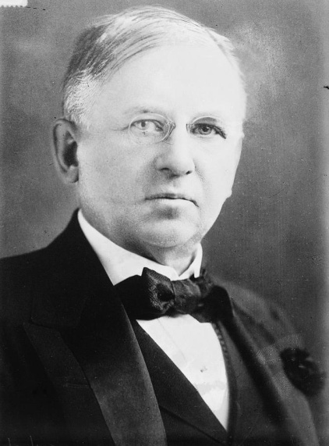
What Is Enabled by Digital?
“Half the money I spend on advertising is wasted; the trouble is I don't know which half ”--- John Wanamaker
Targeting (this lecture); experimentation and measurability (next lecture)
source: https://commons.wikimedia.org/w/index.php?curid=8358951

Slide 3
The Search Ads Market
US search queries
(per month, desktop only)
Global digital ad spend (2016)
15
Other, 9%
12.5
Video, 9%
10
7.5
Searches in billions
Social, 14%
Search, 49%
5
2.5
0
Display, 19%
Jan ‘08
Jul ‘08
Jan ‘09
Jul ‘09
Jan ‘10
Jul ‘10
Jan ‘11
Jul ‘11
Jan ‘12
Jul ‘12
Jan ‘13
Jul ‘13
Jan ‘14
Jul ‘14
Jan ‘15
Jul ‘15
Jan ‘16
Jul ‘16
Jan ‘17
Jan ‘18
Google Sites
Microsoft Sites
Oath*
Ask Network
In 2018, >70% U.S. search ad revenue comes from mobile
source: https://www.statista.com/statistics/265796/us-search-engines-ranked-by-number-of-core-searches/, Magna Global and Guggenheim Securities

Slide 4
Query: Credit Cards
100K
1.6 million queries / month for “credit cards”
90,500
90K
80K
70K
credit cards offers
credit cards reader
credit cards deals
credit cards debt
60K
credit cards compare
credit cards online
Average monthly searches
credit cards for college stud..
50K
credit cards rewards
credit cards details
credit cards 0 interest
40K
credit cards online applicati..
credit cards hdfc
credit cards citi
credit cards capital one
30K
credit cards no foreign trans..
credit cards visa
18,100
credit cards dumps
20K
credit cards interest free
12,100
credit cards starting with 5
credit cards 0
10K
8,100
credit cards 0 purchases
5,400
credit cards Natwest
4,400
4,400
3,600
2,900
2,900
credit cards zip code
2,400
1,900
1,600
1,600
1,300
1,300
1,300
1,000
880
720
720
880
720
640
590
480
480
320
320
390
320
210
210
210
210
140
140
credit cards list
140
260
170
170
110
110
0K
110
20
20
70
20
70
50
50
50
50
40
40
30
90
30
credit cards png
90
credit cards to apply for
credit cards no credit check
credit cards 101
credit cards halifax
credit cards rebuild credit
credit cards high limit
credit cards costco
credit cards money superma..
credit cards that are easy to..
credit cards online approval
credit cards google
2018 data. Google. Source: https://public.tableau.com/profile/ryan.farley#!/vizhome/KeywordResearchCreditBuilder/KeywordVisualizationSlides
credit cards made of metal
credit cards rdc
credit cards us
credit cards martin lewis
credit cards that use experian
credit cards 1000 limit
credit cards secured
credit cards zero balance tra..
credit cards europe
credit cards primary rental c..
credit cards zero interest bal..
credit cards easy to get appr..
credit cards 0 annual fee
credit cards m1 or m2
credit cards used in europe
credit cards 300 limit
credit cards good or bad
credit cards korea
credit cards quickbooks
credit cards 700 credit score
credit cards john lewis
credit card xls
credit cards 3000
credit card 700 dollar limit
credit cards 4 bad credit
credit cards just for gas

Slide 5
Why Use an Auction?
Scale: 100 billion WW queries / month (2018)
Advertiser heterogeneity
AVERAGE COST PER CLICK
AVERAGE CLICK THROUGH RATE
The average cost per click (CPC) in AdWords across all industries is $2.69 on the search network and $0.63 on the display network.
The average click-through rate (CTR) in AdWords across all industries is 3.17% on the search network and 0.46% on the display network.
$8
$6.75
7%
$7
$6.40
6.05
6%
$6
5%
$5
4.41
4.68
$3.33
$3.44
$3.80
4%
4.00
3.78
3.71
$4
$2.78
$2.94
3.27
$3
$2.46
$2.40
$2.62
$2.56
$2.37
3%
2.69
2.91
2.61
2.93
$2.04
$1.53
2.41
2.41
2.42
2.44
2.09
$2
$1.43
$1.16
2%
$1
1%
$0
0%
ADVOCACY
AUTO
B2B
CONSUMER SERVICES
DATING AND PERSONALS
E-COMMERCE
EDUCATION
EMPLOYMENT SERVICES
FINANCE AND INSURANCE
HEALTH AND MEDICAL
HOME GOODS
INDUSTRIAL SERVICES
LEGAL
REAL ESTATE
TECHNOLOGY
TRAVEL AND HOSPITALITY
source: https://www.wordstream.com/blog/ws/2016/02/29/google-adwords-industry-benchmarks
(representing Google AdWords and Display network, 2018 data)

Slide 6

Ad Auctions
ad campaigns
user intent
(user features, “credit cards zero interest”)
Match
1. Rank based on bid x Q
bid₁=$2, Q₁=6. Rank 1
bid₂=$3, Q₂=3. Rank 2
bid₃=$1, Q₂=6. Rank 3
2. Payments
pay $1.5/click
pay $2/click
pay …
Q = f(CTR, relevance, landing page quality)
Q

Slide 9

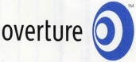
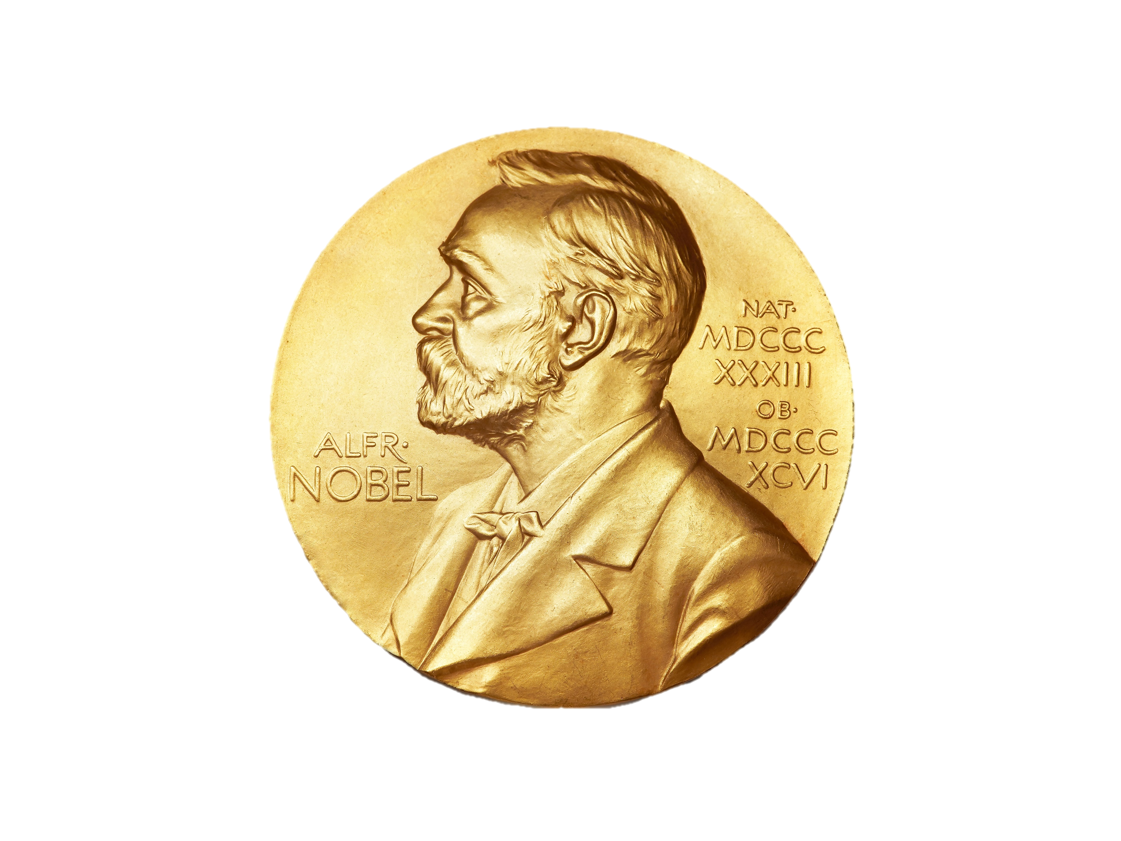
Why Not Charge Bid Price?
Bidding wars on Overture, summer 2002 (had acquired Goto)
Revenue loss Efficiency loss Cost to advertisers Cost to platform
$12
$10
$8
$6
$4
$2
$0
7/18
7/19
7/20
7/21
7/22
7/23
7/24
Source: (Edelman and Ostrovsky, Decision Support Systems 2007)
“COUNTERSPECULATION, AUCTIONS, AND COMPETITIVE SEALED TENDERS
WILLIAM VICKREY
Columbia University
In his Economics of Control, A. P. Lerner threw out an interesting suggestion that where markets are imperfectly competitive, a state agency through ‘counterspeculation’ might be able to create…”
Fix: second-price auction
Charge minimum amount to maintain position

Slide 11
Predicting Clicks
Role of CTR Estimation in Targeting

Slide 12
The Role of CTRs
Ads are ranked by bid x Q
Q depends strongly on CTR, and in turn provides targeting:
CTR
CTR
0.05
0.04
User 1
0.02
User 2
0.01
0.01
0.005

Slide 13
Estimating CTR
Data (x_{t}, y_{t}). y_{t} $∈${0,1} no click or click
Features: x_{t} = (ad/user, contextual, historical) millions, or billions
Title, body, image
Ad ID, merchant ID
URL domain
Product category
User ID
User demographic
Geo location
Local time of day
Day of week
Query: term, length
Query category
Ad position
User device
Average CTR user
Total number of impressions ad
Total number of clicks ad
Average CTR last week ad
Train; adopting a train/test split:
Training data: Days 1–7
Test data: Day 8

Slide 15
Predicting Clicks
Different Models

Slide 16
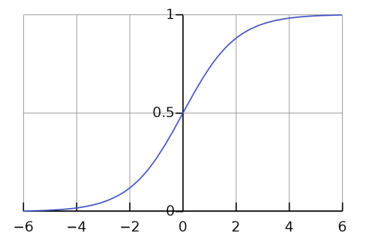
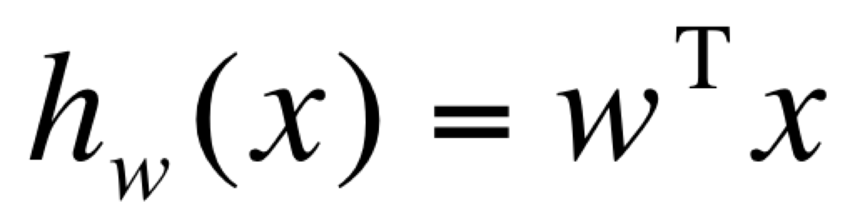
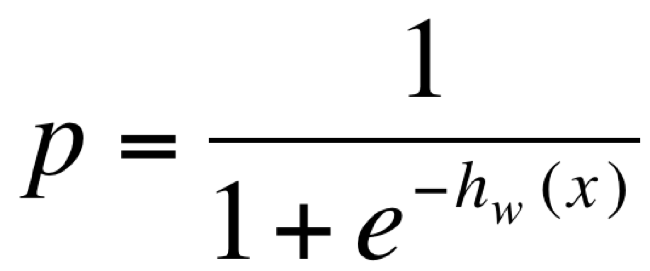
Different Models
Predict probability p of a click, given features x, weights w:
Logistic function
Linear
Logistic regression
Nonlinear
Deep nets
Decision trees
(random forests, gradient-boosted, …)
1
Instance
Fully-connected layer
256
Fully-connected layer
256
…
Batch-Normalization
128
128
ConvNet
Tree-1
Tree-2
Tree-n
Fully-connected layer
source: Wikipedia, Chen et al., ACM Multimedia 2016,
https://medium.com/@williamkoehrsen/random-forest-simple-explanation-377895a60d2d

Slide 17

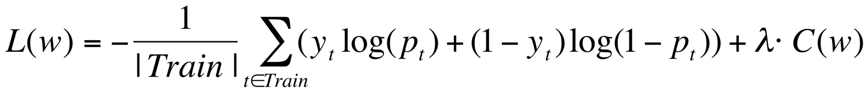
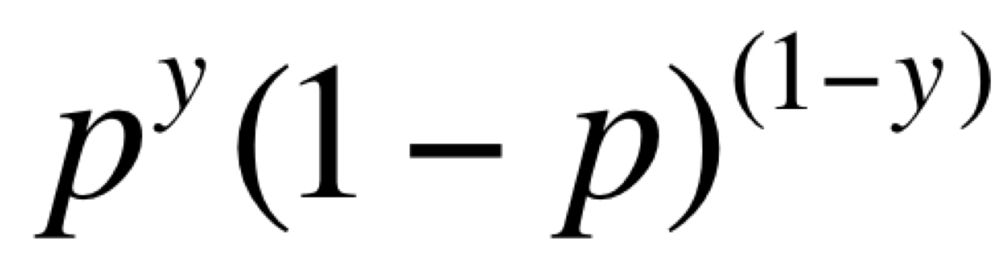
Loss Function
Example (x, y), prediction p
if y = 1, likelihood = p
Likelihood =
if y = 0, likelihood = 1 – p
Negated log likelihood (Loss):
Train: minimize regularized log loss:
Regularization term

Slide 19
Predicting Clicks
Different Metrics

Slide 20
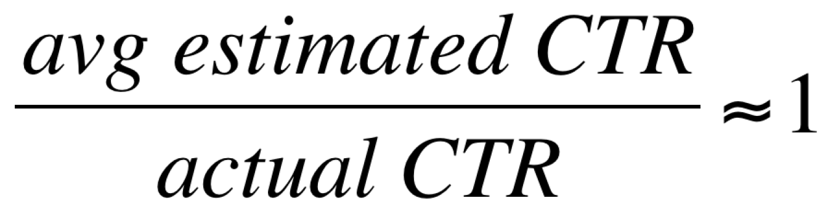
Different Metrics
Accuracy
How well does the trained model predict clicks on new data?
Ranking accuracy
Does the model rank positive examples ahead of negative examples?
Calibration
Calibration curve
Perfect calibration
1.0
logreg
0.8
rf
0.6
True probability in each bin
0.4
0.2
0.0
0.2
0.4
0.6
0.8
1.0
Predicted probability
source: http://changhsinlee.com/python-calibration-plot/

Slide 21
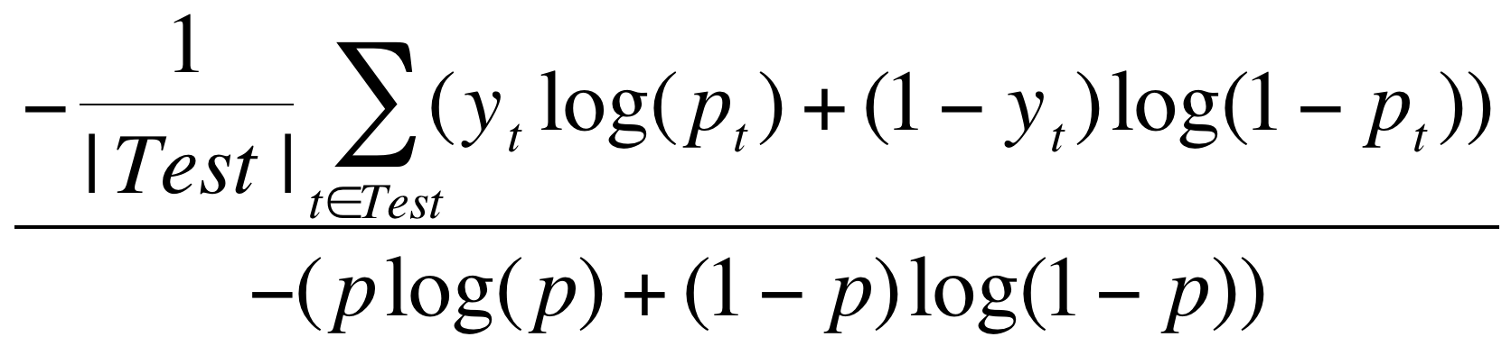
Measuring Accuracy
Log loss on test data
Promotes calibration (if predicts 2x CTR, then normalizing by 0.5 will improve loss)

Slide 22

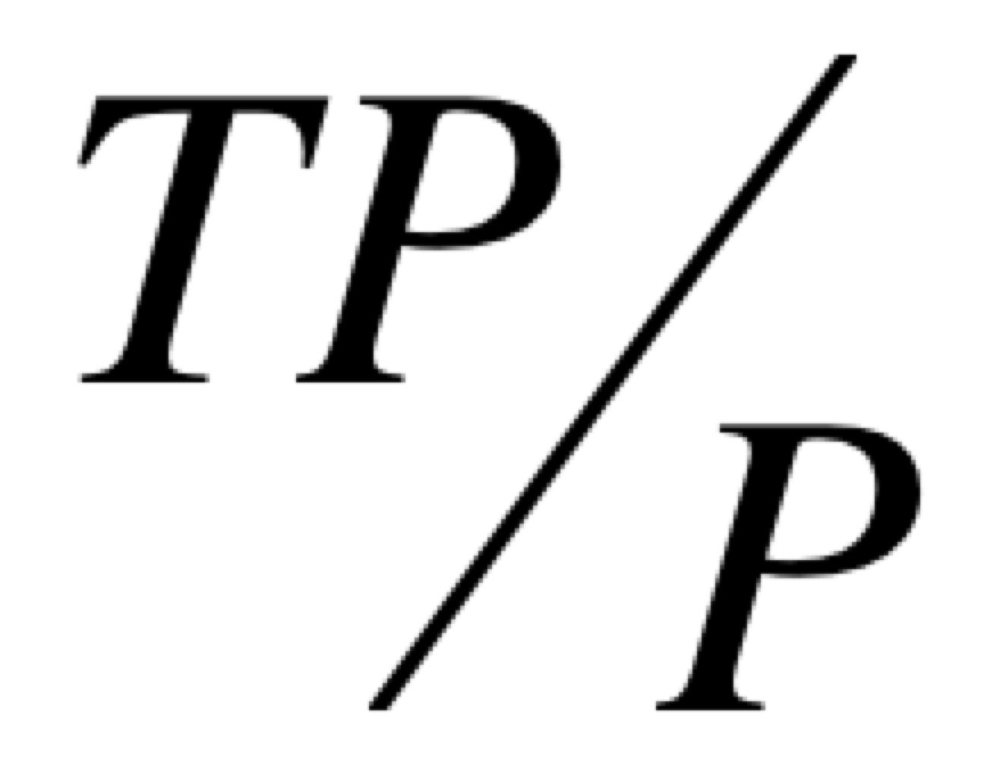
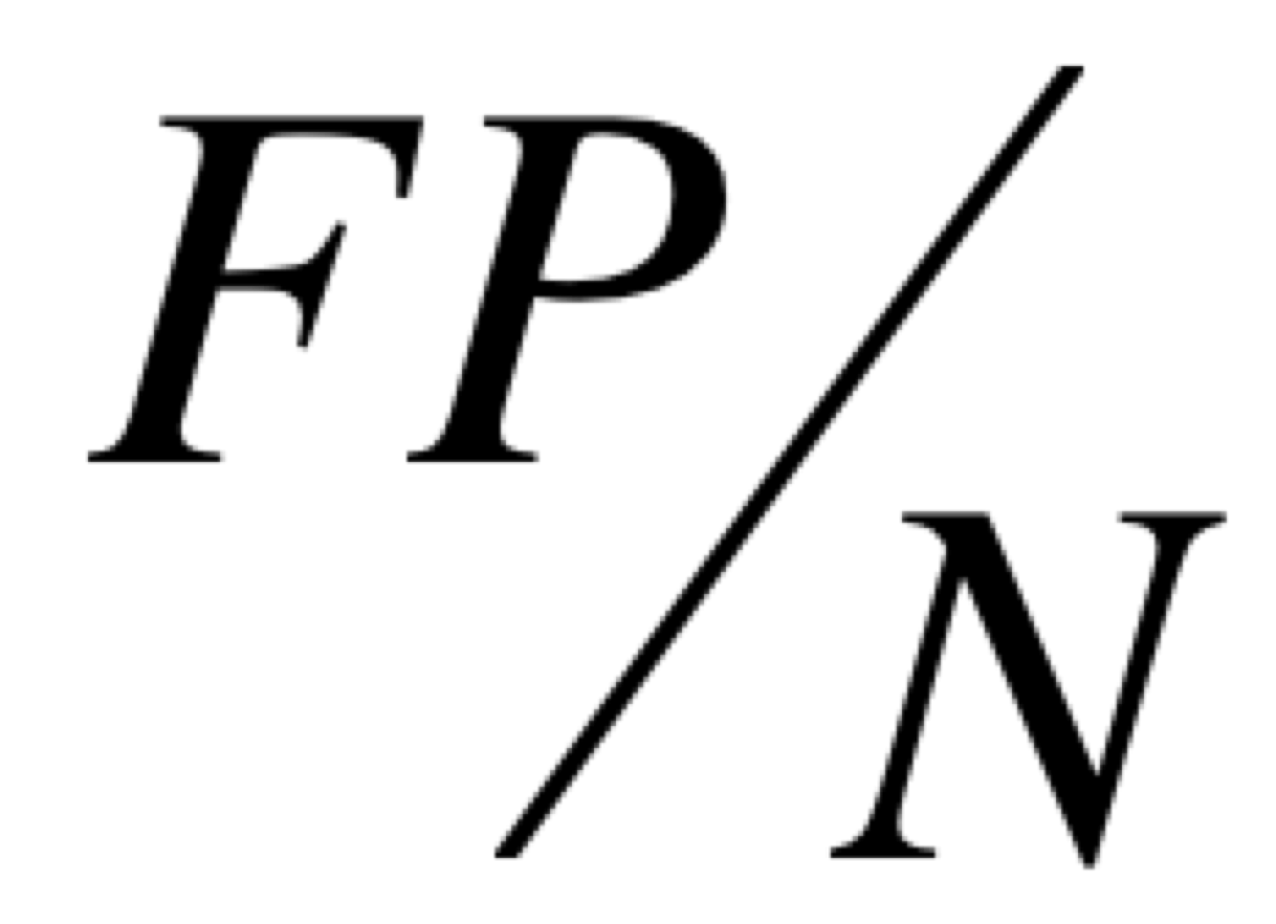
Measuring Rank Accuracy
Classifier: if p>H, then 1, else 0
ROC curve: vary H, plot FPR vs. TPR
 | P | N
1 | True Positives | False Positives
0 | False Negatives | True Negatives
True class
Comparing ROC Curves
A: always “0”. B: always “1”.
C: excellent
D: “1” with prob 0.2.
1
B
0.9
0.8
C
0.7
Predicted class
0.6
0.5
True positive rate
0.4
0.3
Worthless
0.2
D
Good
0.1
Excellent
FP rate = TP rate =
0
A
0
0.1
0.2
0.3
0.4
0.5
0.6
0.7
0.8
0.9
1
False positive rate
source: http://gim.unmc.edu/dxtests/roc3.htm
AUC = area under curve; AUC $∈$ [0.5, 1]
AUC can be interpreted as the probability a random positive example is ranked above a random negative example.
Q

Slide 25
Role of Calibration
Allows for loosely coupled systems, with a separation of concerns
For example, a platform can:
Chain together estimates; e.g., P(purchase) = P(CTR) x P(purchase | click)
Use estimates to project expected, daily spend; automate “budget pacing”
Filter low quality ads, only admitting ads with CTR > = 0.01

Slide 27
Predicting Clicks
Design Choices

Slide 28
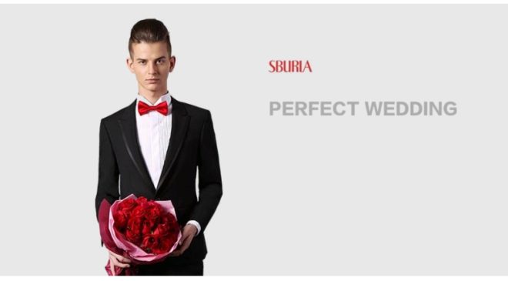
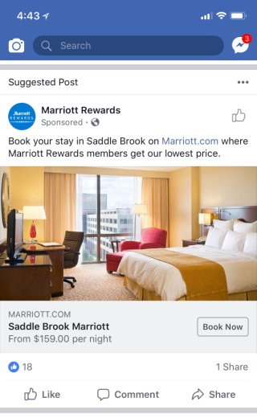
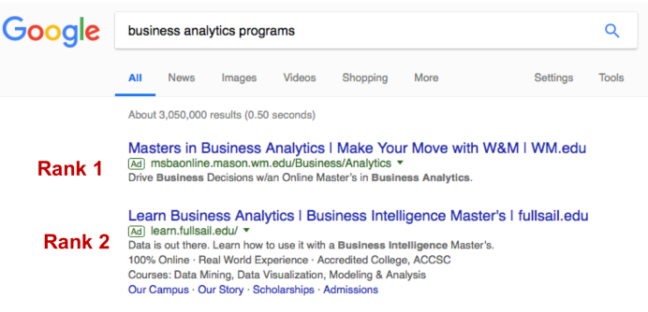
Which Model to Use?
 | Pro | Con
Logistic regression | Scalable, online training Interpretable | Linear (need feature engineering)
Decision trees (gradient boosted, forests…) | Nonlinear effects Interpretable | Approximately 1–2 days to train at very large scale
Deep networks (CNNs, …) | Nonlinear effects Very accurate | Approximately 1–2 weeks to train at very large scale
Display ads at Alibaba
Facebook ads
Sponsored search ads
source: Chen et al., ACM Multimedia 2016
Approximately 150 million ads/day
Approximately 10 billion ads/day
Approximately 3.5 billion searches/day
Q

Slide 31
Which Model to Use?
 | Pro | Con
Logistic regression | Online training Interpretable | Linear (need feature engineering!)
Decision trees (gradient boosted,forests…) | Non-linear effects Interpretable | Approximately1-2 days to train at very large scale
Deep networks (CNNs, …) | Non-linear effects Very accurate | Approximately1-2 weeks to train at very large scale
Display ads at Alibaba
Facebook ads
Sponsored search ads
visual ads, lower velocity
very large scale
very large scale
simpler ads
source: Chen et al., ACM Multimedia 2016
Approximately 150 million ads/day
Approximately 10 billion
ads/day
Approximately 3.5 billion searches/day

Slide 33
Predicting Clicks
Logistic Regression

Slide 34
Logistic Regression at Google
Billions features
Emphasis on sparsity
Stochastic
gradient descent
Probabilistic feature inclusion
Streaming data
Parallelized model training
Sparsification
Calibration
Only include a variable on the m^{th} attempt
Progressive validation metrics
Model serving replicas
L1 regularization
Update log loss estimate automatically, while training
source: McMahan et al., Proc. KDD 2013

Slide 35
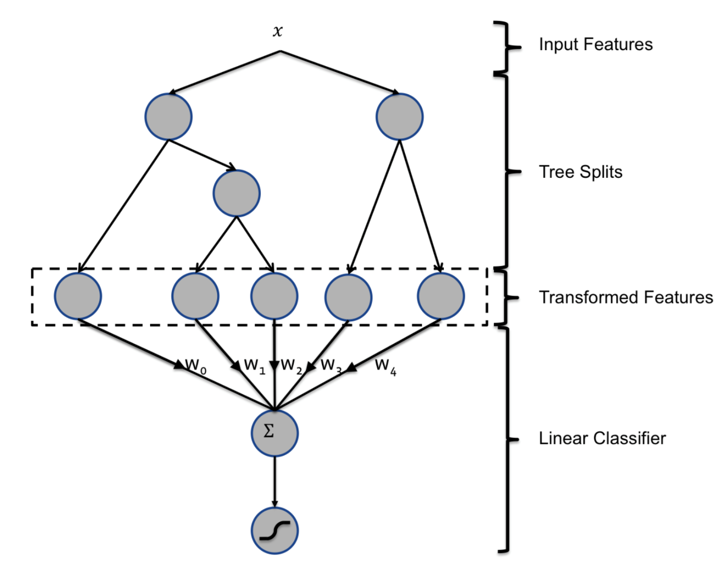
Decision Trees+LR at Facebook
Approximately 10 billion ad impressions/day, many eligible ads
Boosted decision trees
Logistic regression
source: He et al., Proc. ADKDD’14

Slide 36
Decision Trees+LR at Facebook
Trees + LR vs. LR: +0.003 AUC (1% gain in clicks)
Training daily improves performance
Down-sampling of negative examples improves performance
Logistic Regression (LR) and Trees
Trees Only
Norm Logloss (relative to worst case)
100%
102.00%
99%
100.00%
98.00%
98%
96.00%
Normalized logloss (relative to worst case)
94.00%
97%
92.00%
96%
90.00%
88.00%
95%
86.00%
0
1
2
3
4
5
6
0.0001
0.0010
0.0025
0.0050
0.0075
0.0100
0.0250
0.0500
0.0750
0.1000
Training to test set delay (in days)
Fraction of the negative samples employed for learning
source: He et al., Proc. ADKDD’14

Slide 37
Different Kinds of Features
Contextual features
Historical features
Local time of day
Day of week
Device
Current page
…
Cumulative num clicks ad
Cumulative num imprs ad
Average CTR ad last week
Average CTR user
…
Historical features comprise 18 of top 20 most informative features
Q

Slide 40
Use of Contextual Features
Contextual features
Historical features
Local time of day
Day of week
Device
Current page
…
Cumulative num clicks ad
Cumulative num imprs ad
Average CTR ad last week
Average CTR user
…
Historical features comprise 18 of top 20 most informative features
Contextual features remain important for “cold start” (for new users, new ads)

Slide 42
Predicting Clicks
Deep Nets

Slide 43
Deep Nets at Alibaba
0.6 billion goods, 100,000 categories, 60 million users
1 billion features, 2 billion examples.
Predict click on an advertised product
Category | Feature Group | Dimensionality | Type | #Nonzero Ids per Instance
User Profile Features | gender | 2 | one-hot | 1
 | age_level | ~10 | one-hot | 1
 | … | … | … | …
User Behavior Features | visited_goods_ids | ~10⁹ | multi-hot | ~10³
 | visited_shop_ids | ~10⁷ | multi-hot | ~10³
 | visited_cate_ids | ~10⁴ | multi-hot | ~10²
Ad Features | goods_id | ~10⁷ | one-hot | 1
 | shop_id | ~10⁵ | one-hot | 1
 | cate_id | ~10⁴ | one-hot | 1
 | … | … | … | …
Context Features | pid | ~10 | one-hot | 1
 | time | ~10 | one-hot | 1
 | … | … | … | …
Important
‘cate’ = category
Source: Zhou et al., arXiv:1706.06978 (2017)

Slide 44
Deep Nets at Alibaba
Output
Multilayer perceptron
192 X 200 X 80 X 2
Softmax (2)
Goods ID
Shop ID
PReLU/Dice (80)
Cate ID
Other ID
PReLU/Dice (200)
Concat and Flatten
SUM Pooling
X
X
X
Goods 1 Weight
Goods 2 Weight
Goods N Weight
Input
Activation Unit
Activation Unit
Activation Unit
Interact ad and behavior features
Concat
Concat
Concat
Concat
Concat
Concat
16 most recent
goods visited
User profile Features
Goods 1
Goods 2
Goods N
Candidate Ad
Context Features
User Behaviors
Source: Zhou et al., arXiv:1706.06978 (2017)

Slide 45
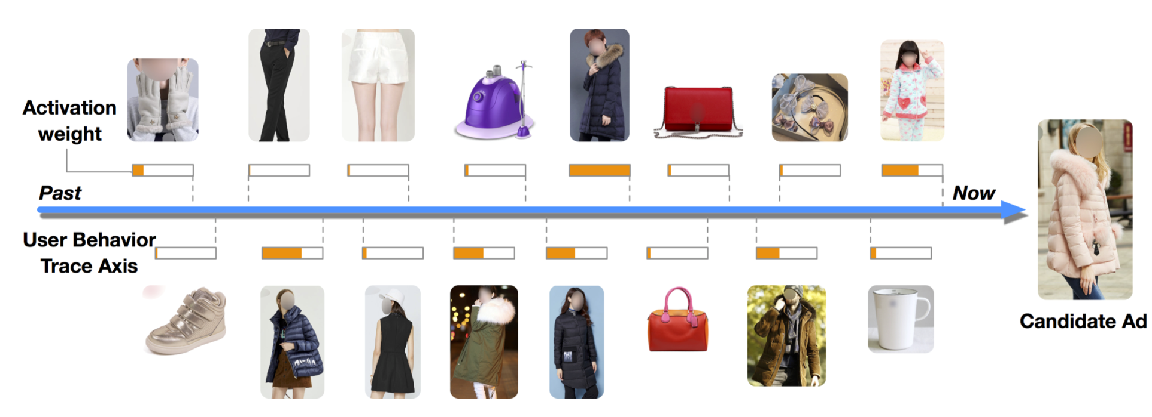
Deep Nets at Alibaba
Learns to identify partial overlap with past behavior; also temporal effects (most recent view is important)

Slide 46
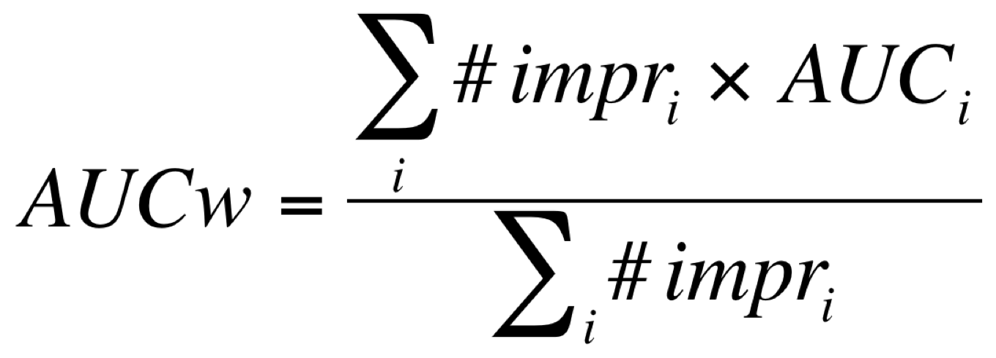
Deep Nets at Alibaba
Metric: user-weighted AUC
Logistic regression 0.574; Deep net 0.608
A/B test (May 2017)
+10% CTR; +3.8% revenue
Effect of regularization:
Train Loss
Test AUC
0.235
0.230
0.60
0.225
0.59
0.220
Loss
AUC
0.58
0.215
No Goods id
No Goods id
0.210
Goods id without Reg
Goods id without Reg
Goods id Dropout
0.57
Goods id Dropout
0.205
Goods id Filter
Goods id Filter
Goods id with Reg in Difacto
Goods id with Reg in Difacto
Goods id with MBA Reg
Goods id with MBA Reg
0.200
0.56
0
0.5
1
1.5
2
0
0.5
1
1.5
2
Epoch
Epoch
Source: Zhou et al., arXiv:1706.06978 (2017)

Slide 47
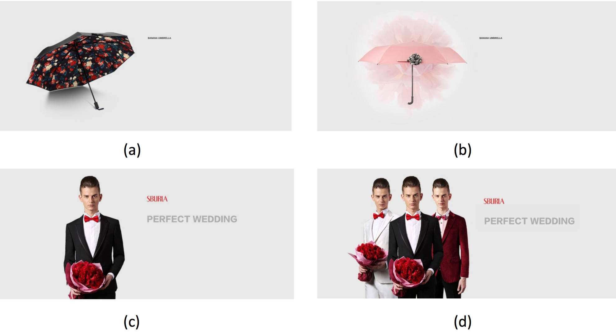
What about Images
Q

Slide 49
Which image do you think will perform better? (a) or (b)? (c) or (d)?

Slide 50
The Effect of Images
1.27% CTR
0.83% CTR
2.40% CTR
2.23% CTR
source: Chen et al., ACM Multimedia 2016

Slide 51

Understanding Images
4 conv layers
4 conv layers
4 conv layers
4 conv layers
Conv, 5×5, 32
Conv, 3×3, 32
Conv, 3×3, 32
Conv, 3×3, 64
Conv, 3×3, 64
Conv, 3×3, 128
Conv, 3×3, 128
Conv, 3×3, 256
Conv, 3×3, 256
Fully-connected layer
Batch-Normalization
112×112
56×56
56×56
28×28
14×14
7×7
128
Fully-connected layer
Fully-connected layer
256
256
1
CNNs have been trained at Alibaba on 1 week of data
120,000 images, 150,000 advertisers, 60 million examples
Pre-trained on ImageNet
Results (vs. LR with basic features):
AUC +0.005
CTR +1% (estimated)
Fully-connected layer
0 0 1 0
200,000
128
1 0 0 1
gender, age, ad ID, ad location, ad category, …
source: Chen et al., ACM Multimedia 2016

Slide 52
Summary: Predicting CTR
Q = f(CTR, relevance, landing page quality)
CTR = click through rate of ad in top position
How relevant is the ad to the query?
Where does an ad redirect the user?
Has a vital role in ad targeting
A useful system should be:
Accurate, well-calibrated
Adapt to new data (ideally, train time <1 day)
Scalable (billions of features and examples)

Slide 54
Real-Time Bidding

Slide 55
Real-Time Bidding
Ad exchanges:
Right MediaX ’05–’15 (acquired Yahoo), DoubleClickX ’07 (Google AdX), AppNexusX ’11, FBX ’12 (now Audience Network)
Auction for impressions, while web page loads—a second-price auction
Supply-side platforms, e.g. Google DoubleClick for Publishers
Demand-side platforms, e.g. Criteo
Direct = inventory sold in blocks, not real time
RTB = impressions transacted in real time
US Display (non negotiated)
60
40.03
34.09
40
27
Spending in billion U.S. dollars
20.64
20
13.62
22.72
25.59
16.21
19.55
12.07
0
(RTB was $2B in 2012)
2016
2017
2018*
2019*
2020*
Real-time bidding
Programmatic direct
Q
Source: eMarketer, March 2018; Statista

Slide 58
Benefits of Real-Time Bidding
For advertisers:
Retargeting
Brings in third-party data (online <> offline)
Experiments
For publishers:
Can better monetize user impressions
Can sell first-party data
Better control (premium vs. remnant)

Slide 59
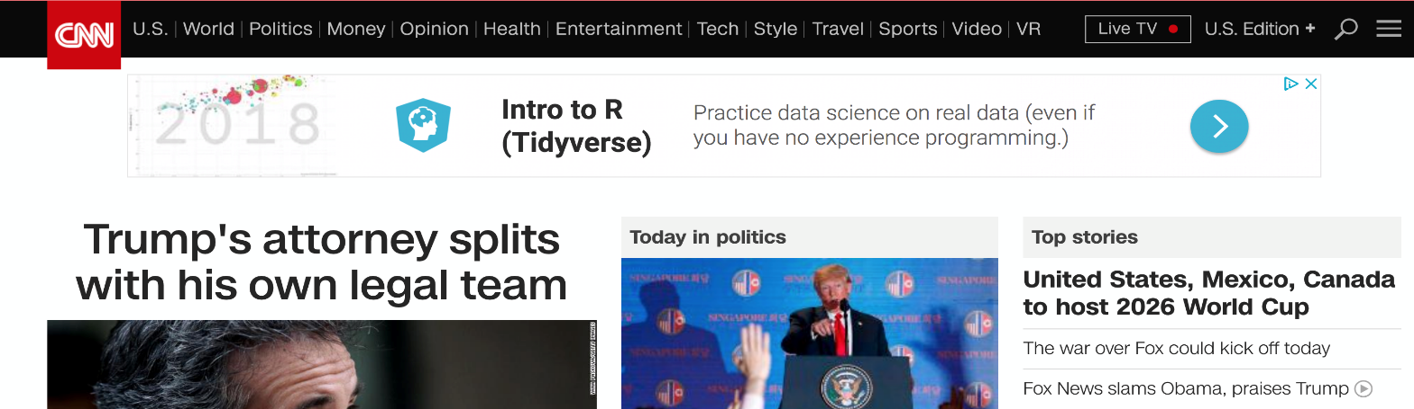

Retargeting
You visited Orbitz, now a hotel ad follows you…
Cookies! Small text files, saved by your browser:
First-party cookies: created by a site you visit directly, used for login, shopping cart, etc.
Third-party (“tracking”) cookies: created by another website— Orbitz can also serve the “pixel” of a DSP, say Criteo; Criteo can now read/write its own cookie
source: cnn.com; https://www.designcrowd.com/design/3484433

Slide 60
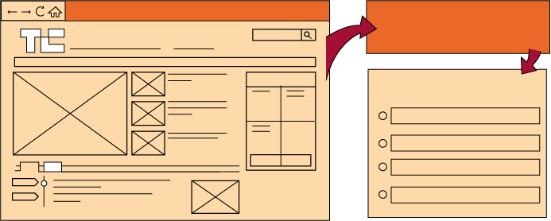
Retargeting in Detail (1 of 2)
Orbitz places JavaScript from Criteo on its site
When a user visits Orbitz:
Criteo pixel fires, and it can write a third-party cookie (“UserID = 123456”)
JavaScript sends Criteo the user’s behavior (e.g., add-to-cart, purchases, etc.)
www.orbitz.com
3rd party cookie USER ID = 123456
Criteo’s
DATABASE
source: https://clearcode.cc/blog/cookie-syncing/

Slide 61
Retargeting in Detail (2 of 2)
3
DSP1 (Criteo)
4
DSPs place bids
“ABCDEF”
1
cnn.com
AdX
DSP2
5
AdX clears auction
2
Read “ABCDEF”
DSP3
6
AdX serves ad
User visits cnn.com
1
Google AdX reads its own third-party cookie (“UserID = ABCDEF”),
2
3
makes call-outs with this ID to DSPs.
DSPs bid; e.g., Criteo maps “ABCDEF” → “123456,” bids on behalf of Orbitz
4
[Criteo can “Cookie map” because, in parallel with , AdX also fires a Criteo pixel, passing “ABCDEF”]
2

Slide 62
Header Auctions
Response to concern that SSPs such as DoubleClick may privilege certain exchanges (e.g., allowing Google AdX to cherry-pick)
Header auctions are conducted via JavaScript in a user’s browser (may also move server-side)
Introduced by AppNexus in 2009
Publisher can collect bids, and decide to sell or pass impression to an ad exchange
V

Slide 65
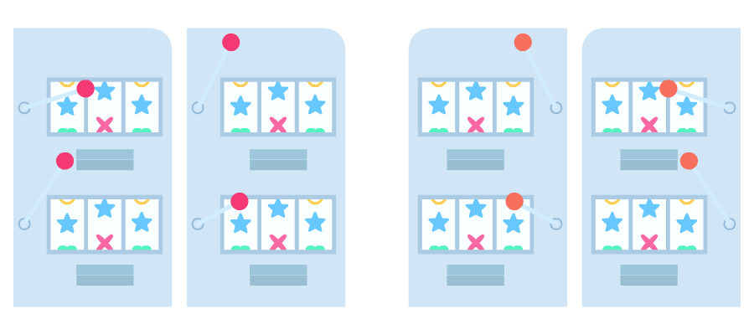

Dynamic Creative Optimization
A “multi-armed bandit problem”
Balance explore (trying new things) and exploit (using creatives that are known to work well)
source: https://tech.gotinder.com/smart-photos-2/

Slide 66
Data Management Platforms
Data brokers (e.g., Acxiom and Nielsen) trade in user data, buying data from credit cards, supermarkets, etc.
Data management platforms (e.g., Oracle BlueKai, Adobe AudienceManager) provide analytics services to advertisers; including matching users with offline data via PII such as name, email and ZIP code
One such service is Prospecting

Slide 67
Prospecting
“Find me people who look like people who love me”
Collect data, both online and offline, about current customers (the target population)
Build a predictive model: is a user in this target population? For example, via logistic regression
From this, create an audience segment that overweights the predictive features

Slide 69
Privacy

Slide 70
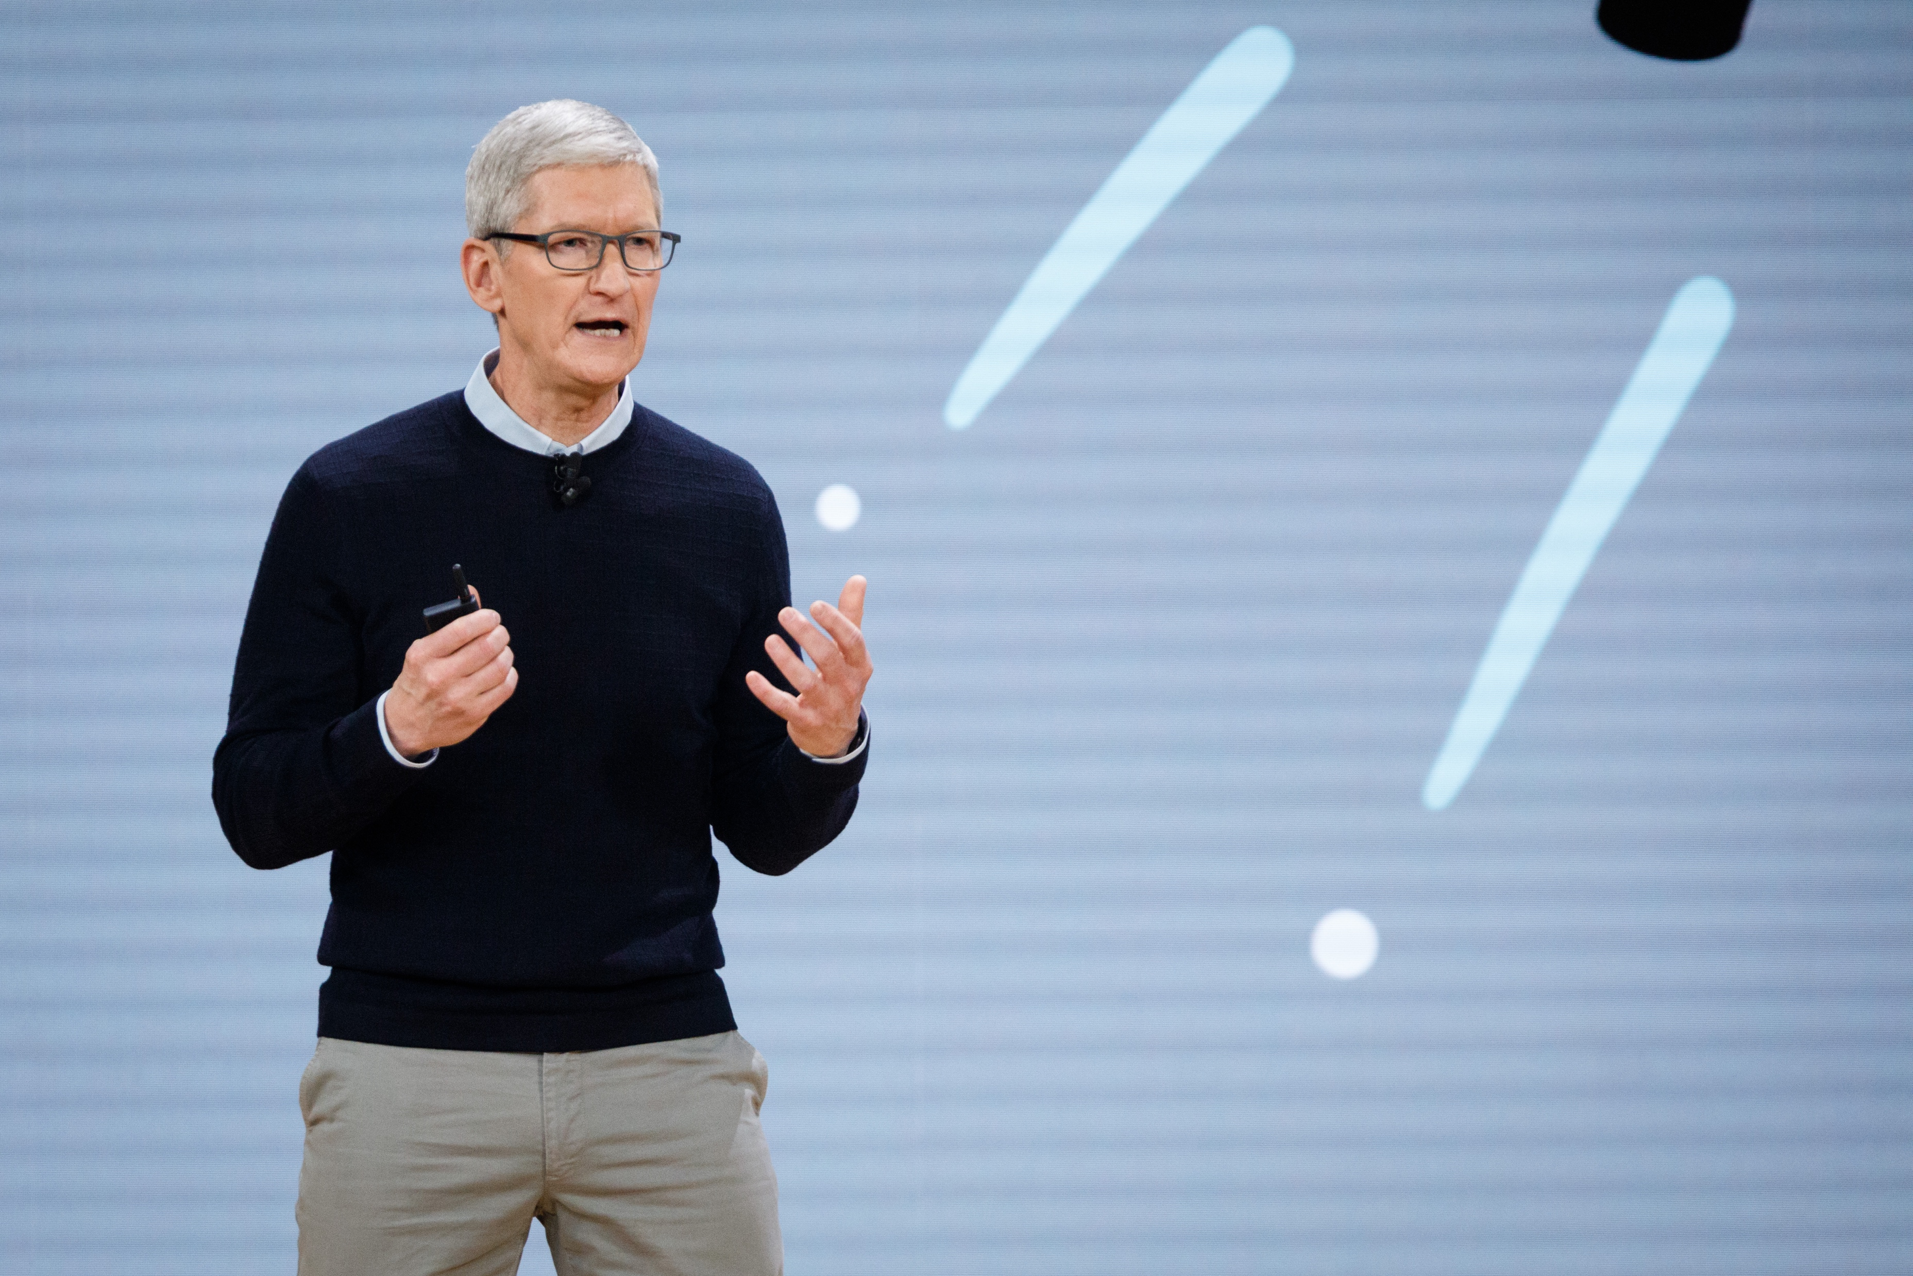
Tracking on iPhones
iOS blocks third-party cookies
Behavioral tracking must be achieved through first-party cookies
Platform serving ad needs to get a click, so that it can drop a first-party cookie; use this for tracking
June, 2017. Intelligent Tracking Prevention (ITP1)
Announced by Apple CEO, Tim Cook
Machine learning detects first-party
cookies used for tracking
Now cookie only valid for 24 hours.
source: https://www.nbcnews.com/tech/apple/here-s-everything-apple-just-revealed-its-annual-conference-n768421

Slide 71

Deeply Concerned
September 14, 2017, letter from Major Ad Trade Groups:
“We are deeply concerned about the Safari 11 browser update that Apple plans to release, as it overrides and replaces existing user-controlled cookie preferences with Apple’s own set of opaque and arbitrary standards for cookie handling.”
source: https://www.prnewswire.com/news-releases/major-ad-trade-groups-release-joint-letter-outlining-deep-concerns-over-cookie-handling-functionality-of-apples-safari-11-browser-300519829.html
Apple
No tracking, no revenue: Apple’s privacy feature costs ad companies millions
Ad-tech firm Criteo likely to cut its 2018 revenue by more than a fifth after Apple blocked ‘pervasive’ tracking on web browser Safari
Tue 9 Jan 2018
Source: https://www.theguardian.com/technology/2018/jan/09/apple-tracking-block-costs-advertising-companies-millions-dollars-criteo-web-browser-safari
V

Slide 75

A Deepening Arms Race
June, 2018. Intelligent Tracking Prevention 2.0
Announced by Apple software chief, Craig Federighi
No 24-hour grace period (a user will have to approve a cookie)
Also block “browser fingerprinting”
“We’ve all seen these like buttons, share buttons and comment fields. … these can be used to track you, whether you click them or not. … we’re shutting that down.”
source: https://www.houstonchronicle.com/business/technology/article/Apple-previewing-updates-for-iPhones-Siri-and-12966125.php

Slide 76
General Data-Protection Regulation
May 2018: companies that collect, use, process, and share data about EU citizens must comply with the GDPR
“Personal data” includes IP addresses, device IDs, location data, and cookies
Consent must be “freely given, specific, informed, and unambiguous,” and required for each data-processing activity

Slide 77
Data Breaches
May 2007: Facebook opens its platform—“We want to make Facebook into something of an operating system,” M. Zuckerberg, Facebook CEO
April 2015: Facebook shuts down the “friends’ data” API (now a friend needs to authorize the app)
March 2018: Cambridge Analytica accessed personal data of 87 million users (acquired via app "thisisyourdigitallife,” used by 270,000 users in 2014-15)
March 2018: Facebook tightens user data an app can access (no news browsing, games activity, political views, …, only name, photo, and email)

